Slide 1

PeachTree

Slide 2
About us
Notes:
Introduce ourselves
Natasha - Talk about previous websites created, what they achieved and any issues we had
Hennah – Unique selling point
Joe - Talk about how we incorporate many new agile techniques to improve security
Anisa – Mention Analytics
Transition – ‘So lets talk about what we’ve been doing recently’

Slide 3
About the project
Notes:
What is the University Magazine Contribution website?
Explain the problem (need students to contribute)
Explain how the system would be implemented (use existing university email addresses and pwds)
What does the system do?
Go through use case for each type of user
Transition – ‘Lets look at some examples of the system in action’

Slide 4
Administrator experience

Slide 5
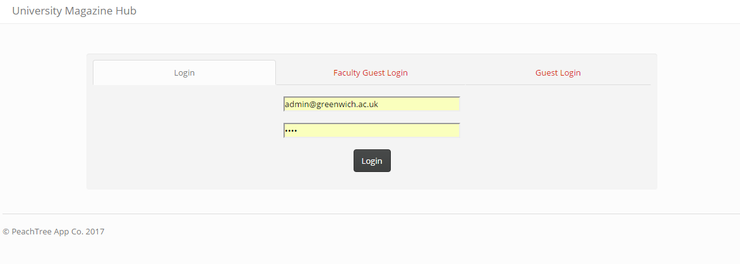
Login

Slide 6
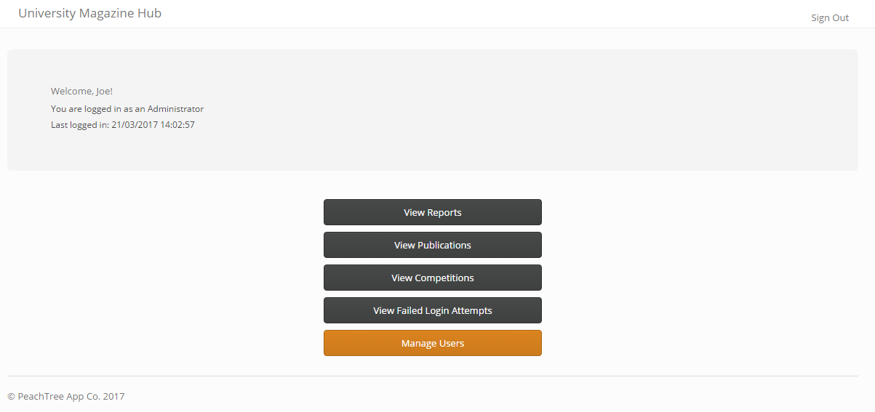
Home

Slide 7
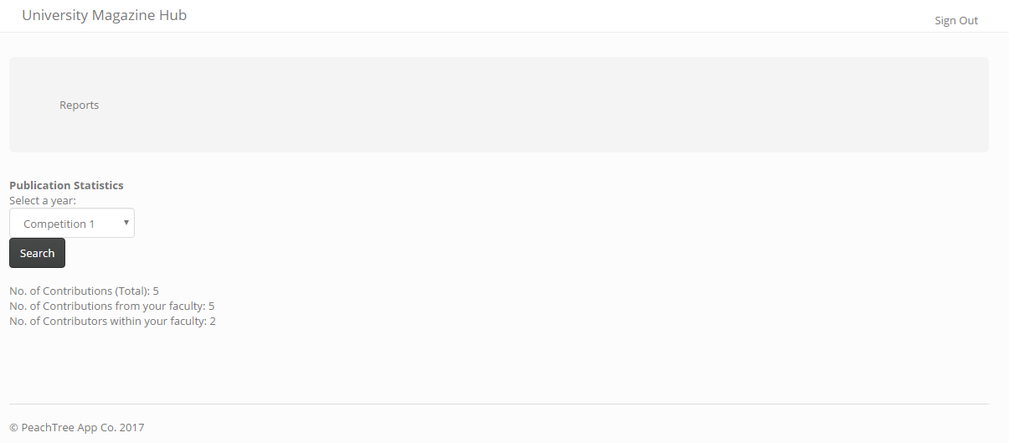
Reports

Slide 8
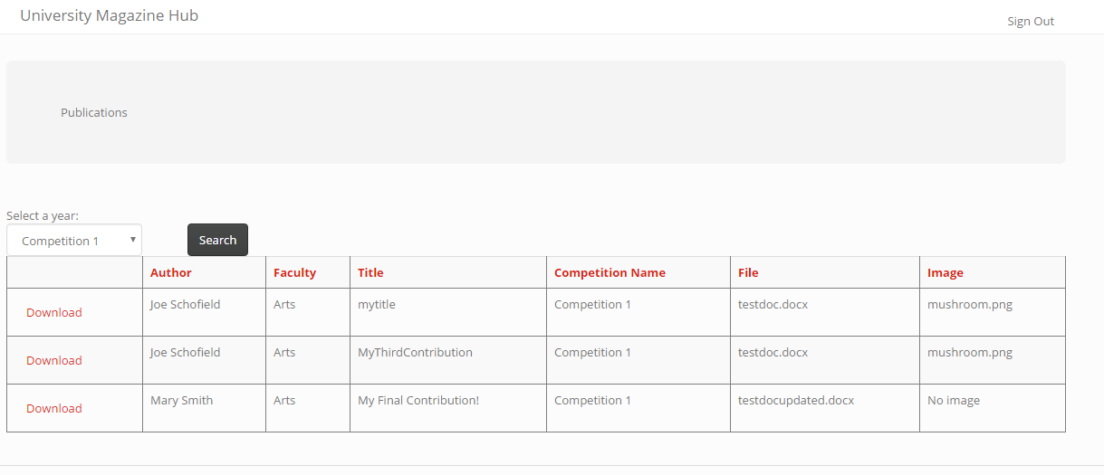
Publications

Slide 9
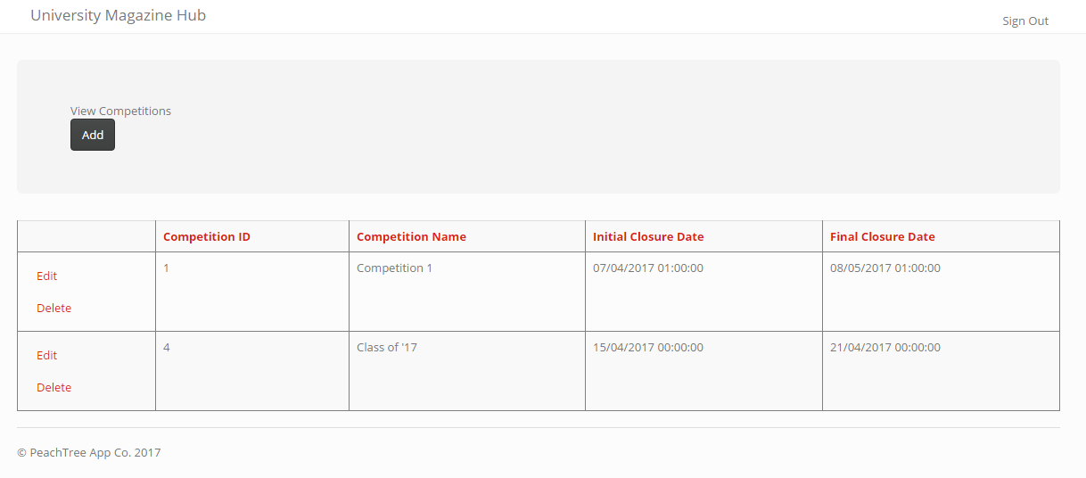
Competitions

Slide 10
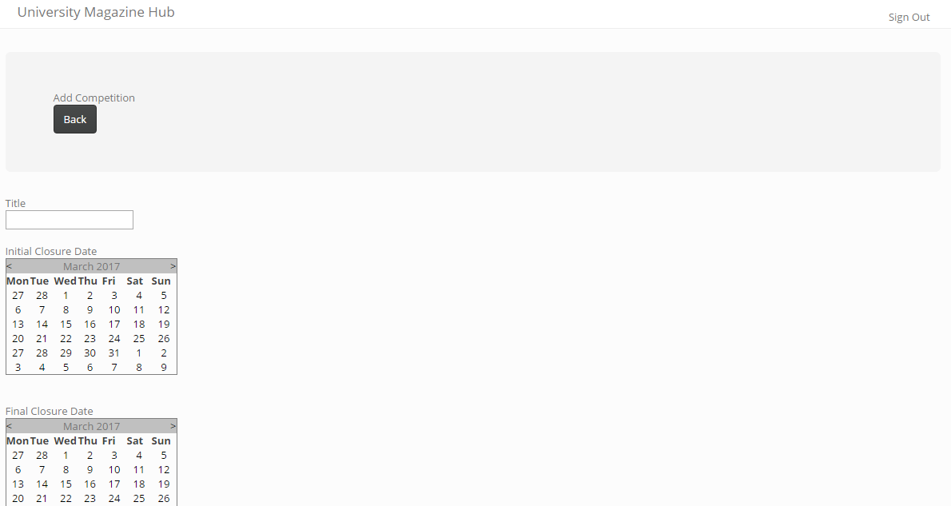
Competitions

Slide 11
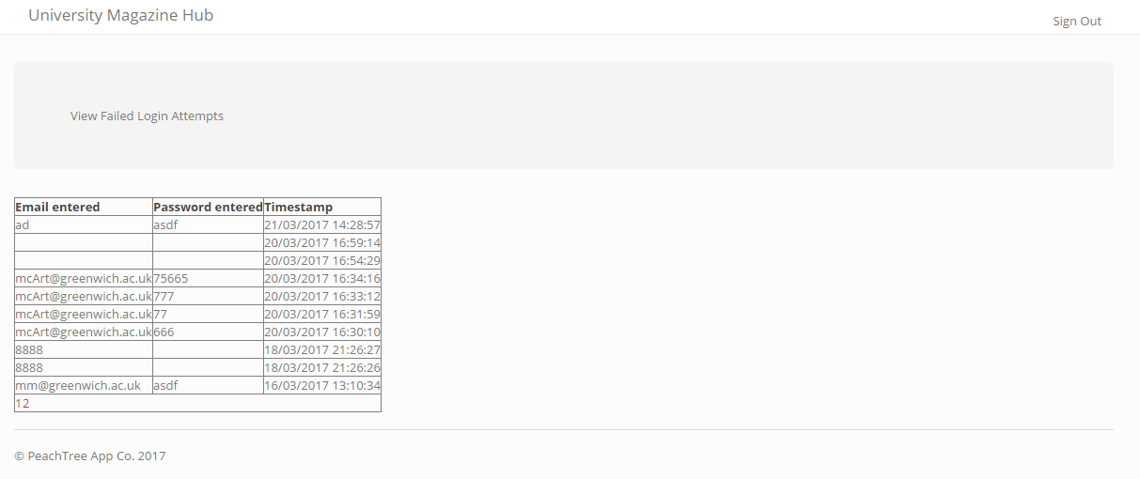
Failed Login Attempts

Slide 12
Student experience

Slide 13
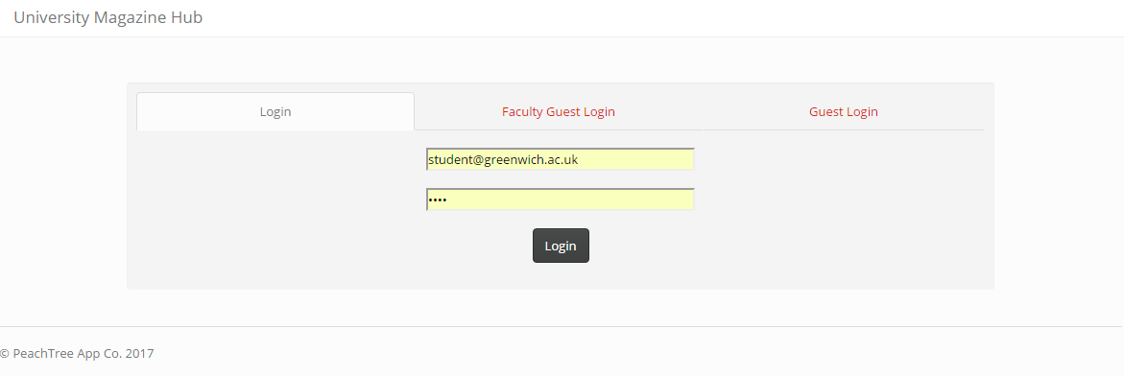
Login

Slide 14
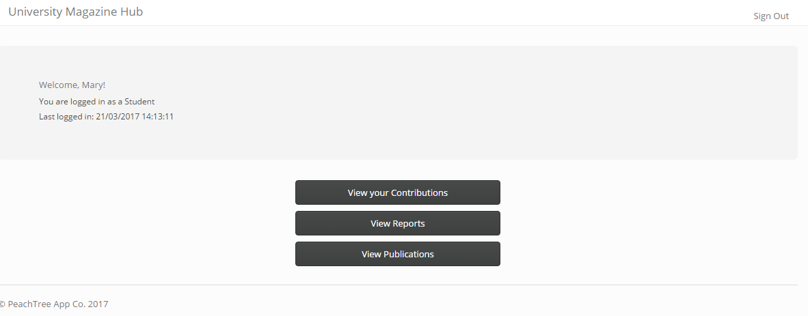
Home

Slide 15
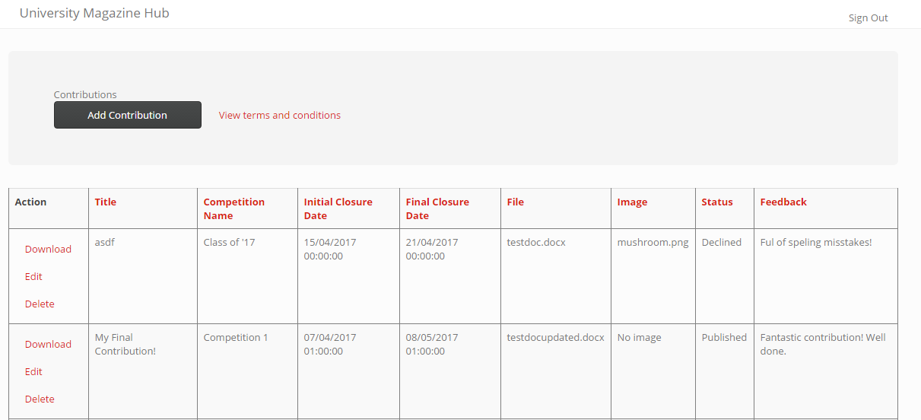
Contributing

Slide 16
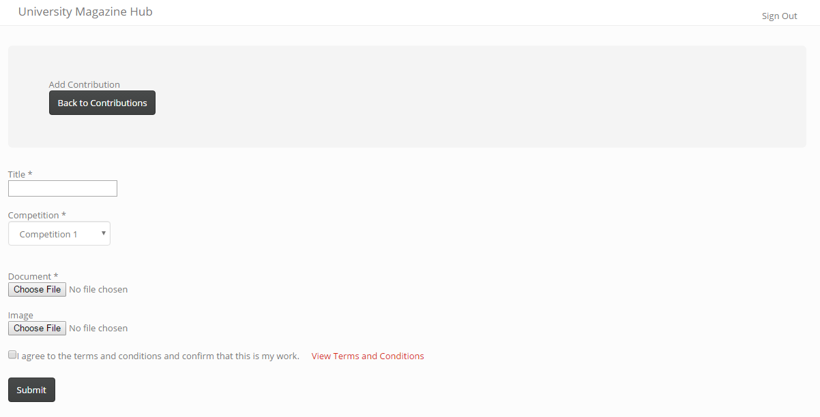
Contributing

Slide 17
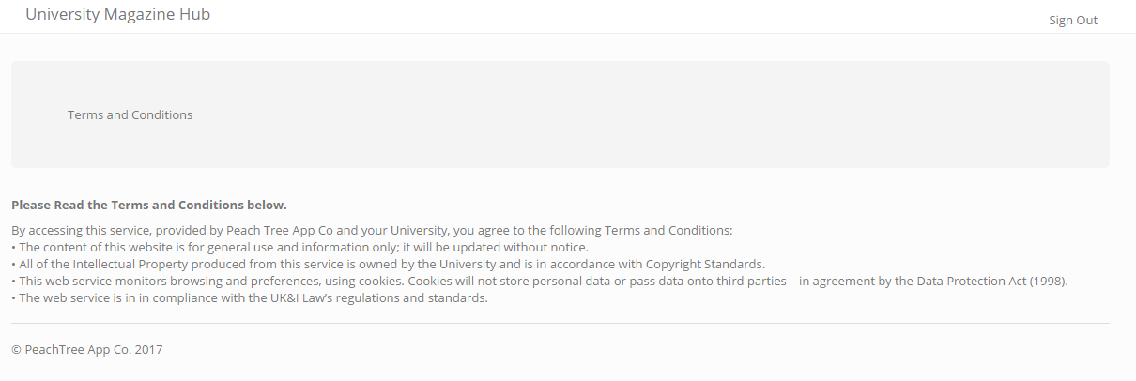
T’s & C’s

Slide 18
Reports

Slide 19
Publications

Slide 20
Marketing Manager
experience

Slide 21
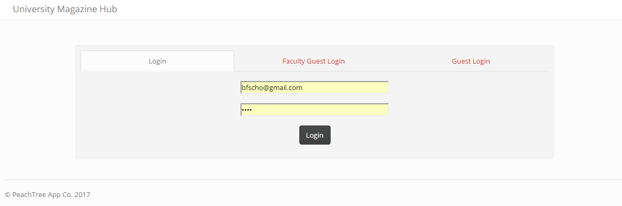
Login

Slide 22
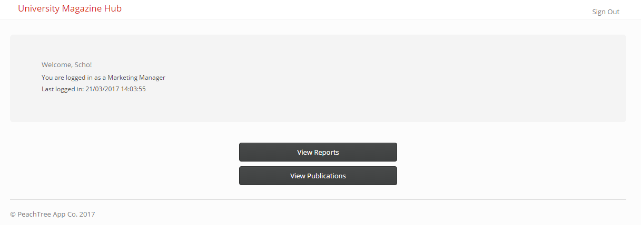
Home

Slide 23
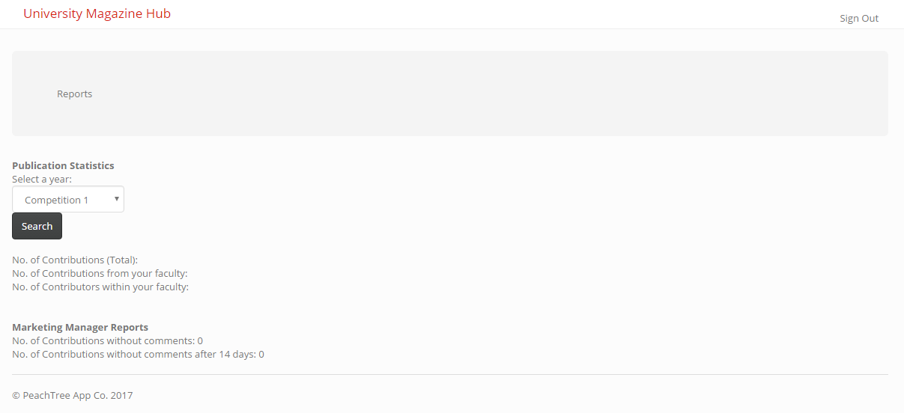
Reports

Slide 24
Publications

Slide 25
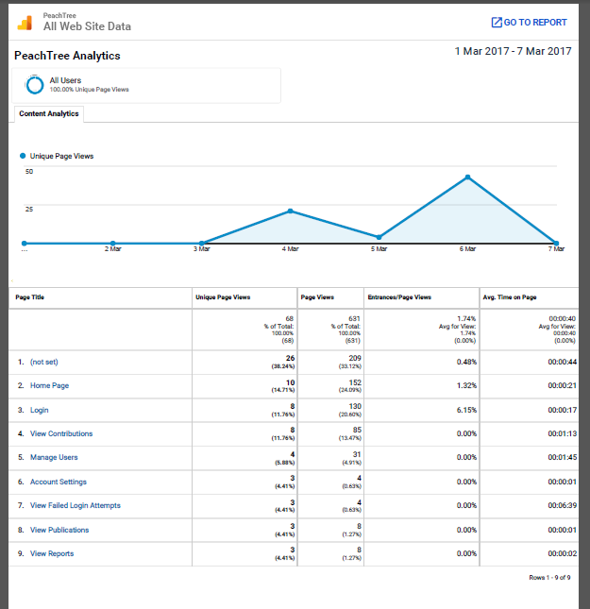
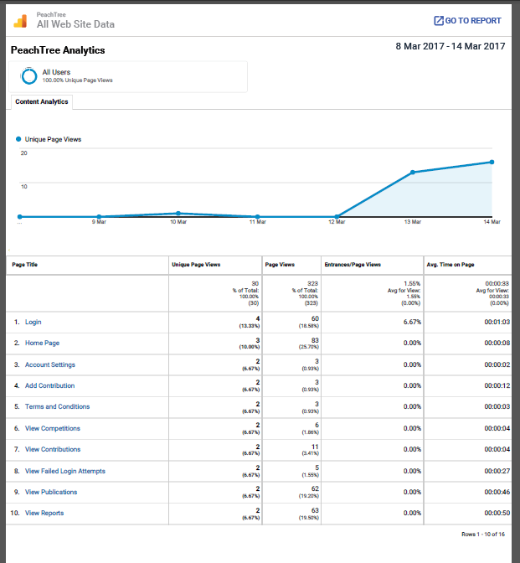
Analytics

Slide 26
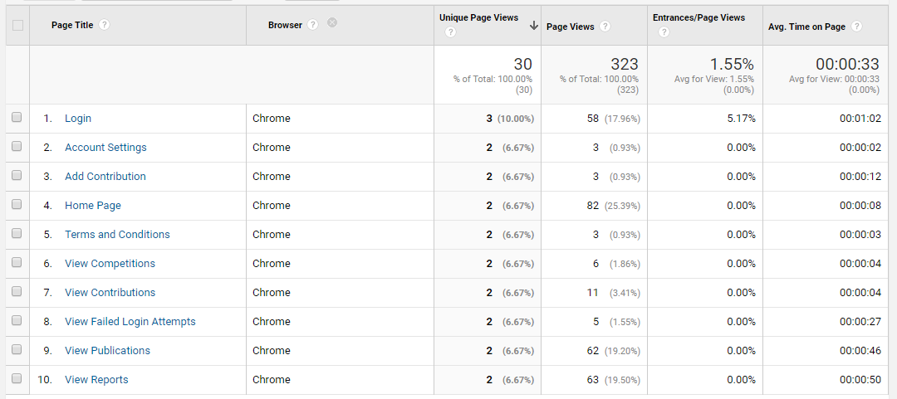
Analytics

Slide 27
Marketing Coordinator
experience

Slide 28
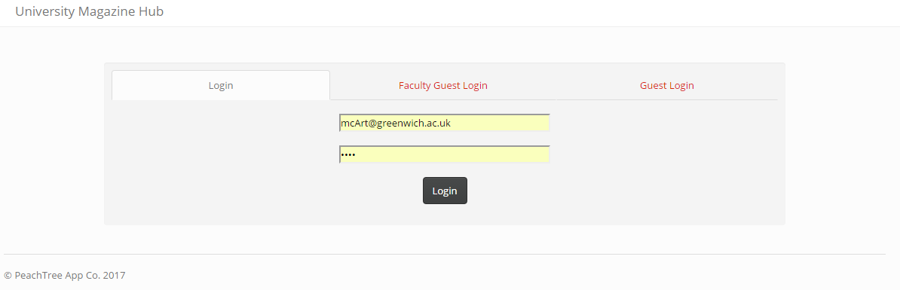
Login

Slide 29
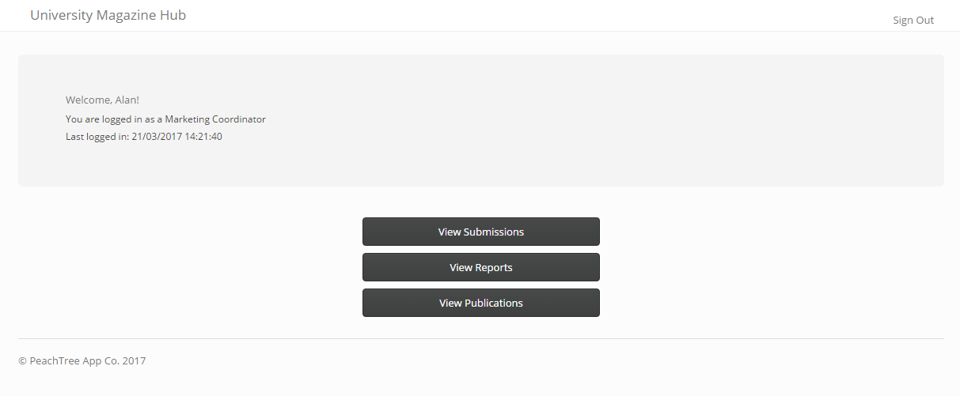
Home

Slide 30
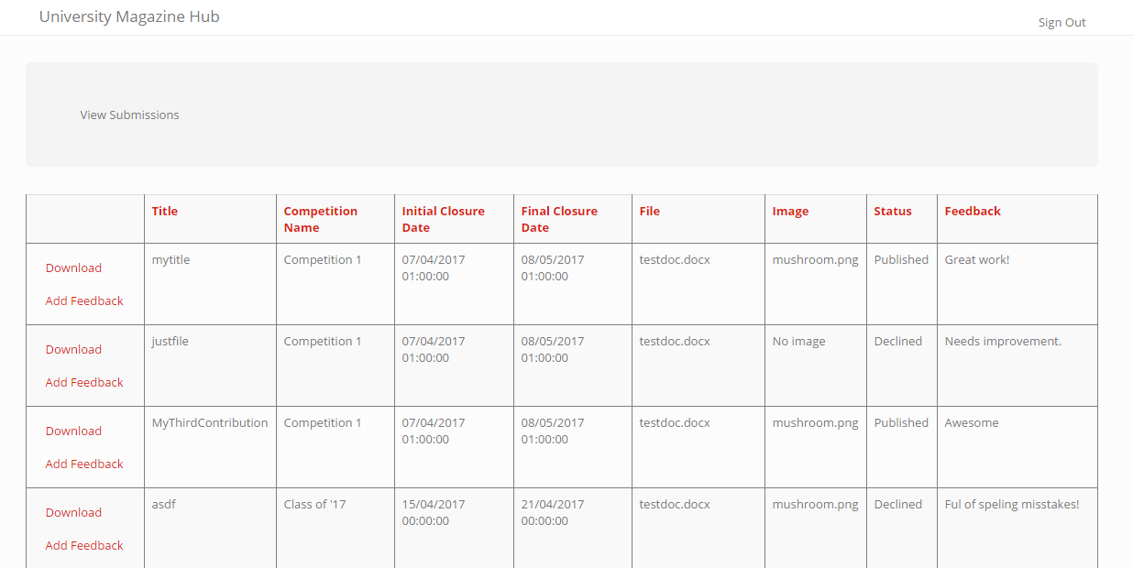
Submissions

Slide 31
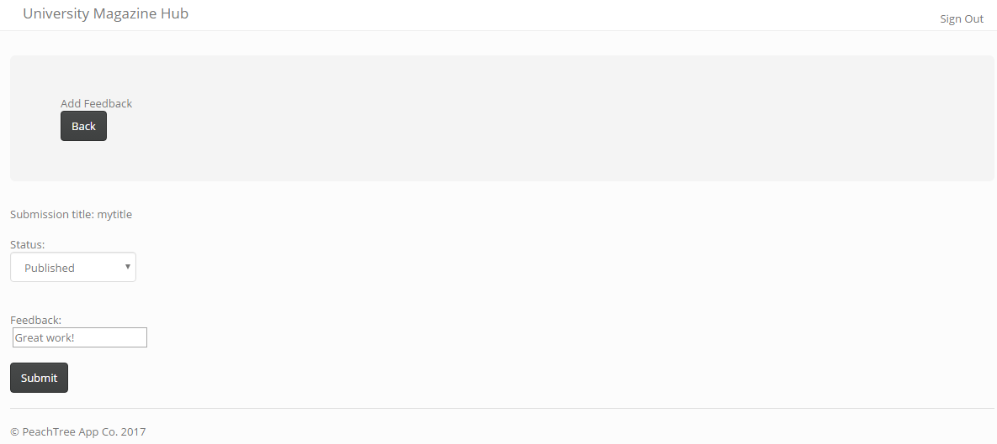
Feedback

Slide 32
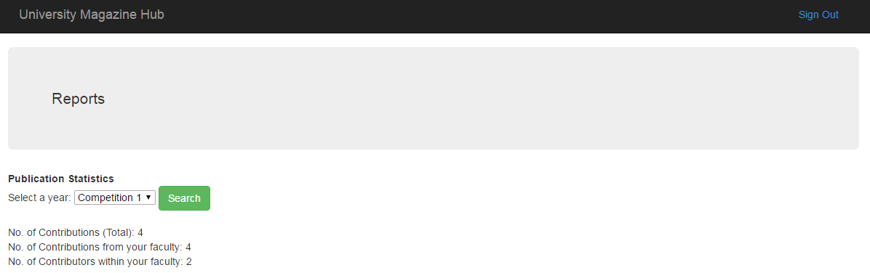
Reports

Slide 33
Publications

Slide 34
Guest experience
Notes:
This experience is for people who may not belong to any faculty in the university, but are interested in viewing past publications of the magazine.

Slide 35
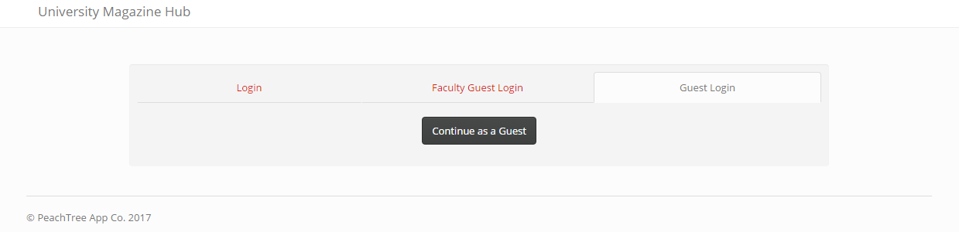
Login

Slide 36
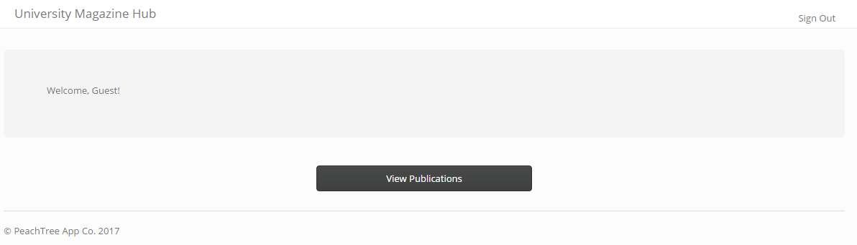
Home

Slide 37
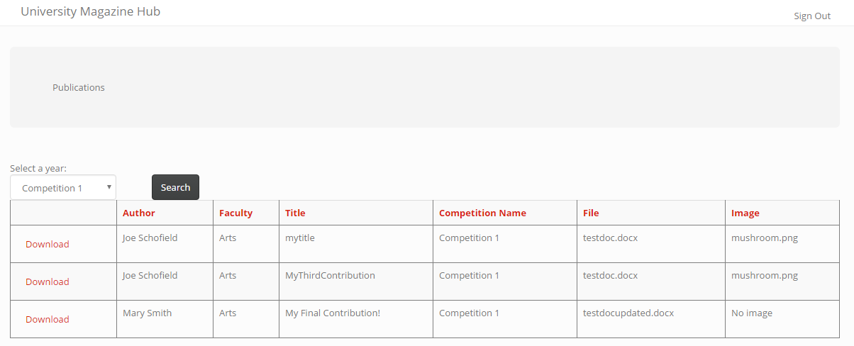
Publications

Slide 38
Faculty guest experience

Slide 39
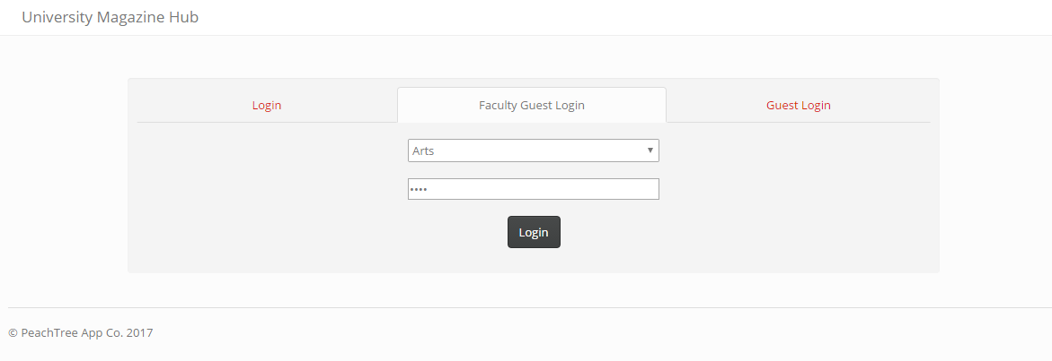
Login

Slide 40
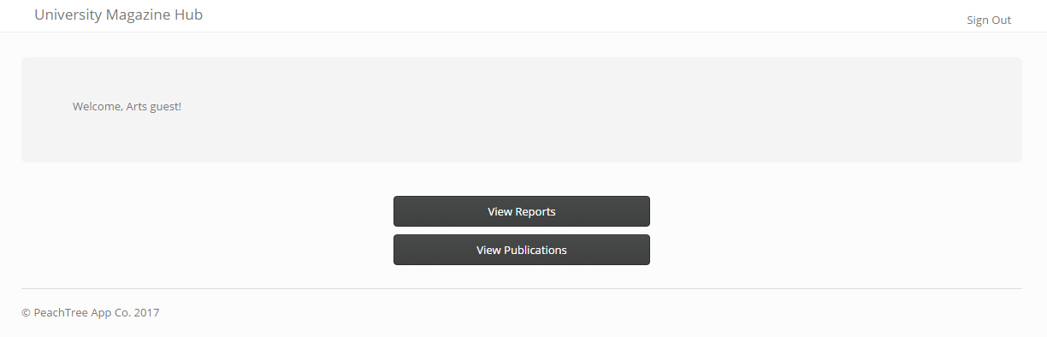
Home

Slide 41
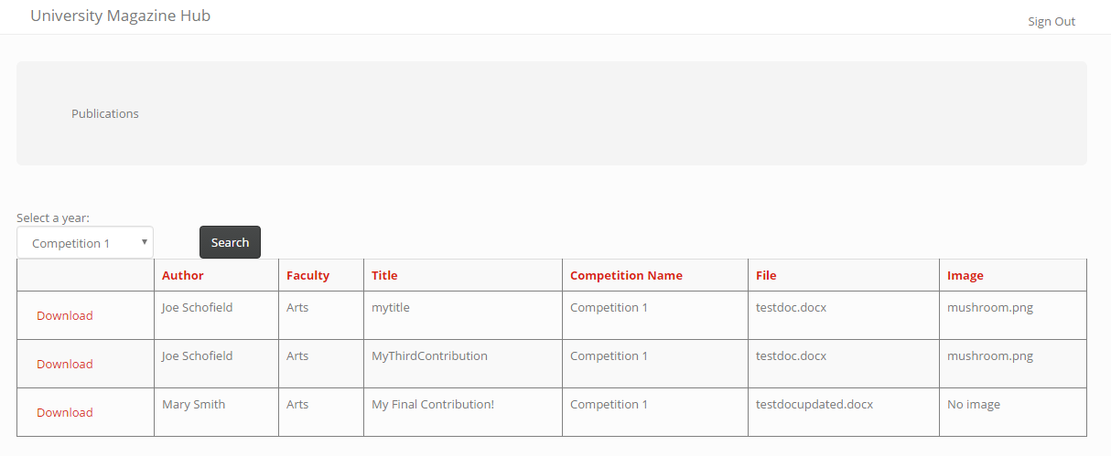
Publications

Slide 42

Reports

Slide 43
Future
Notes:
Mention how in the future we will improve:
UI
Add more functionality to:
Manage users
Fine tune analytics to see more valuable results
Graphical representations of reports
Download images
Download all reports from closed competitions in a zip for marketing manager

Slide 44
Questions

